Slide 1
Linear Algebra
线性代数
Zongbin Chen YMSC, Tsinghua University
陈宗彬 清华大学数学科学中心
Email: zbchen@tsinghua.edu.can

Slide 2


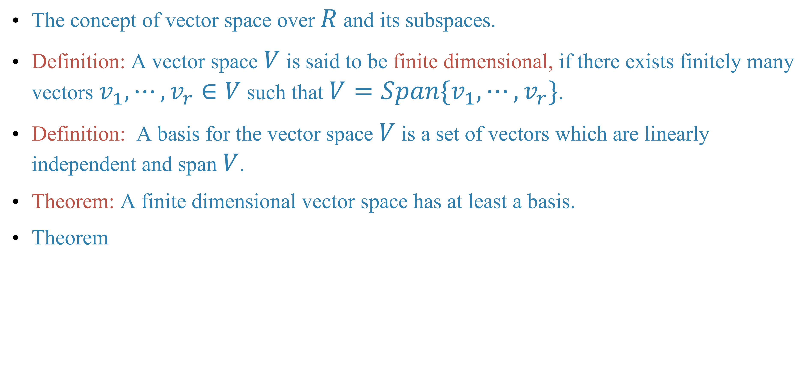

Quick review
The concept of vector space over $R$ and its subspaces.
Definition: A vector space $V$ is said to be finite dimensional, if there exists finitely many vectors $v_{1},⋯,v_{r}∈V$ such that $V=Span\{v_{1},⋯,v_{r}\}$.
Definition: A basis for the vector space $V$ is a set of vectors which are linearly independent and span $V$.
Theorem: A finite dimensional vector space has at least a basis.
Theorem

Slide 3
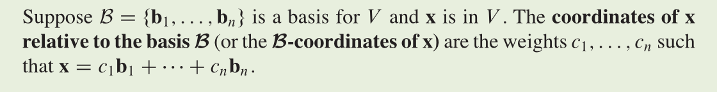
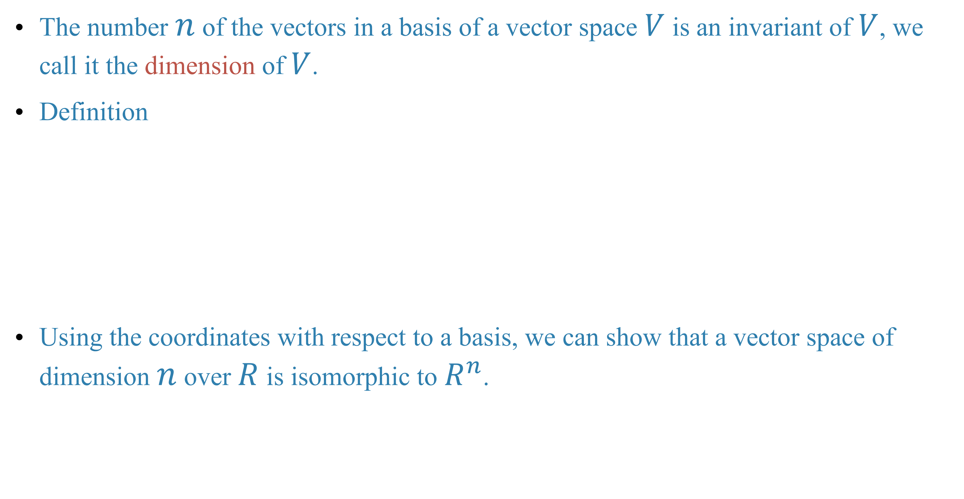
The number $n$ of the vectors in a basis of a vector space $V$ is an invariant of $V$, we call it the dimension of $V$.
Definition
Using the coordinates with respect to a basis, we can show that a vector space of dimension $n$ over $R$ is isomorphic to $R^{n}$.

Slide 4
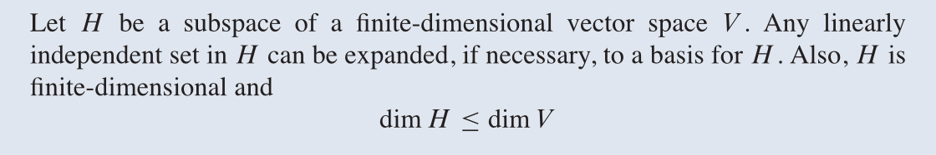
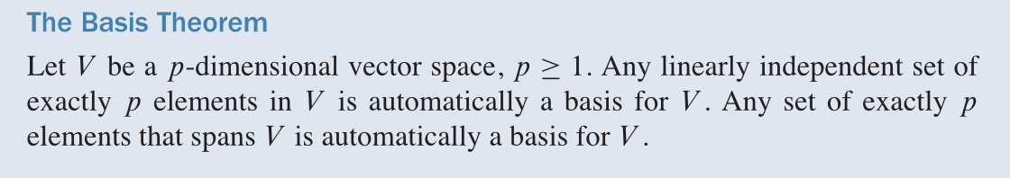
Theorem
Theorem

Slide 5
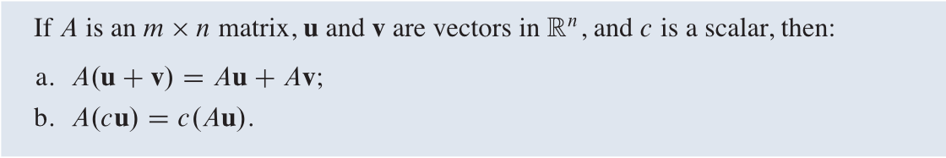
Linear transformation
Recall

Slide 6
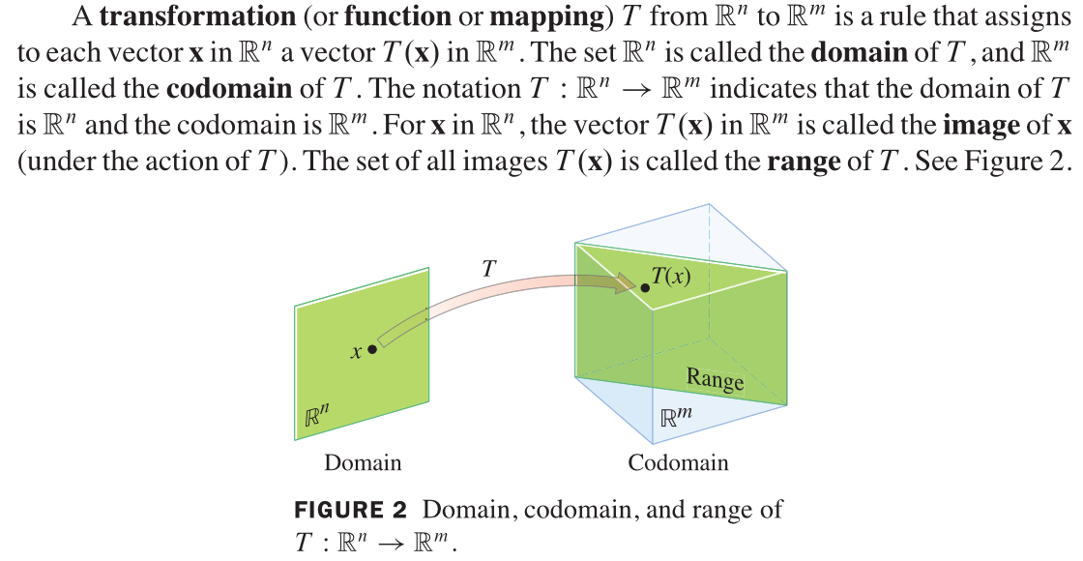
Terminology: transformation(变换), mapping(映射), domain(原像), codomain(值域), image(像), range(像集).

Slide 7
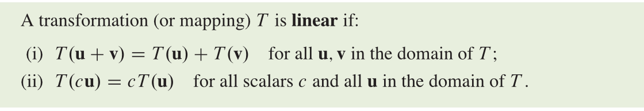
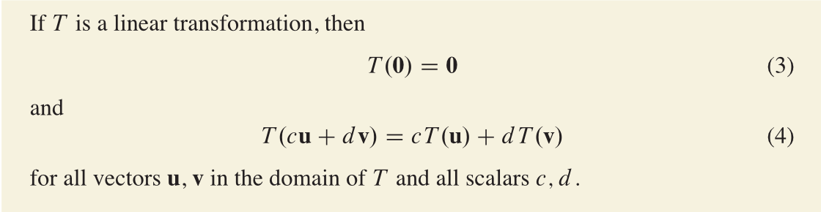
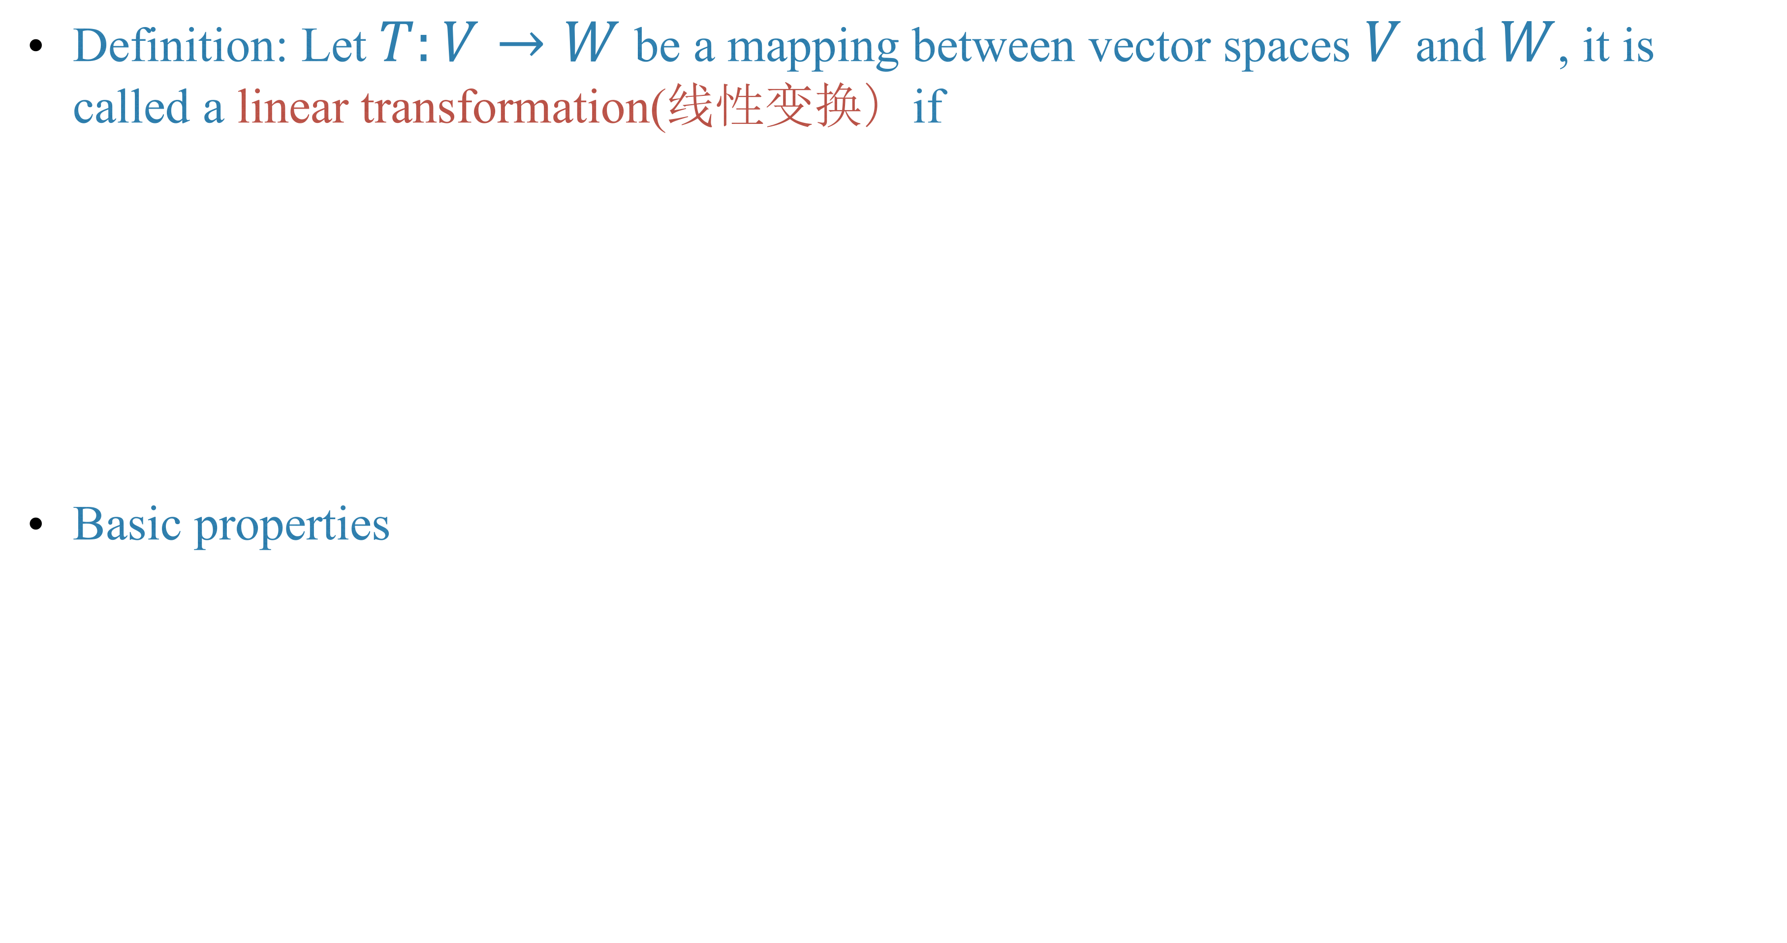
Definition: Let $T:V→W$ be a mapping between vector spaces $V$ and $W$, it is called a linear transformation(线性变换）if
Basic properties

Slide 8
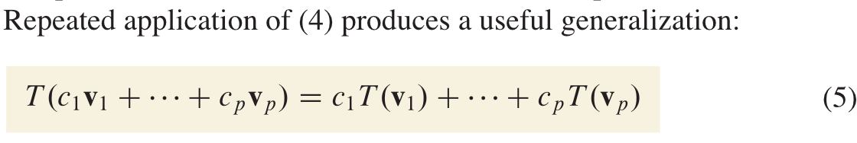
The physicists call it the superposition principle(叠加原理).

Slide 9
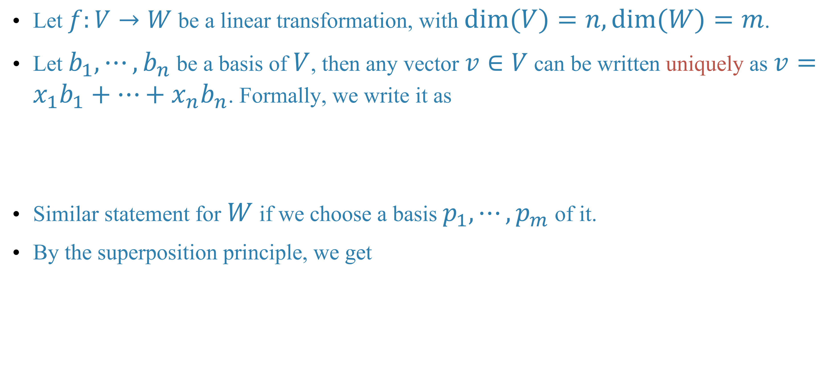
The matrix of a linear transformation
Let $f:V→W$ be a linear transformation, with $dim(V)=n,dim(W)=m$.
Let $b_{1},⋯,b_{n}$ be a basis of $V$, then any vector $v∈V$ can be written uniquely as $v=x_{1}b_{1}+⋯+x_{n}b_{n}$. Formally, we write it as
Similar statement for $W$ if we choose a basis $p_{1},⋯,p_{m}$ of it.
By the superposition principle, we get

Slide 10
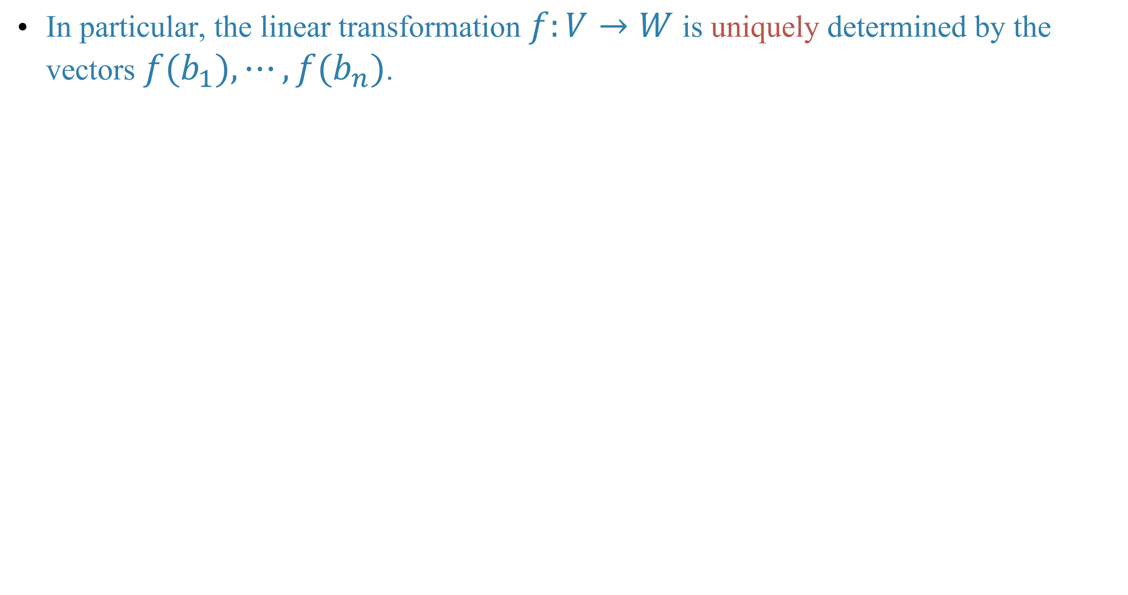
In particular, the linear transformation $f:V→W$ is uniquely determined by the vectors $f(b_{1}),⋯,f(b_{n})$.

Slide 13
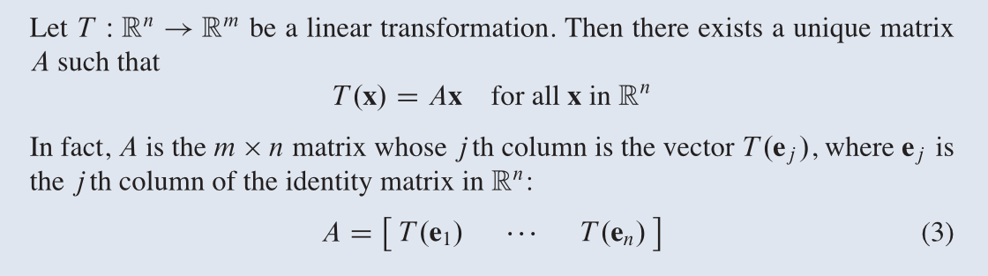
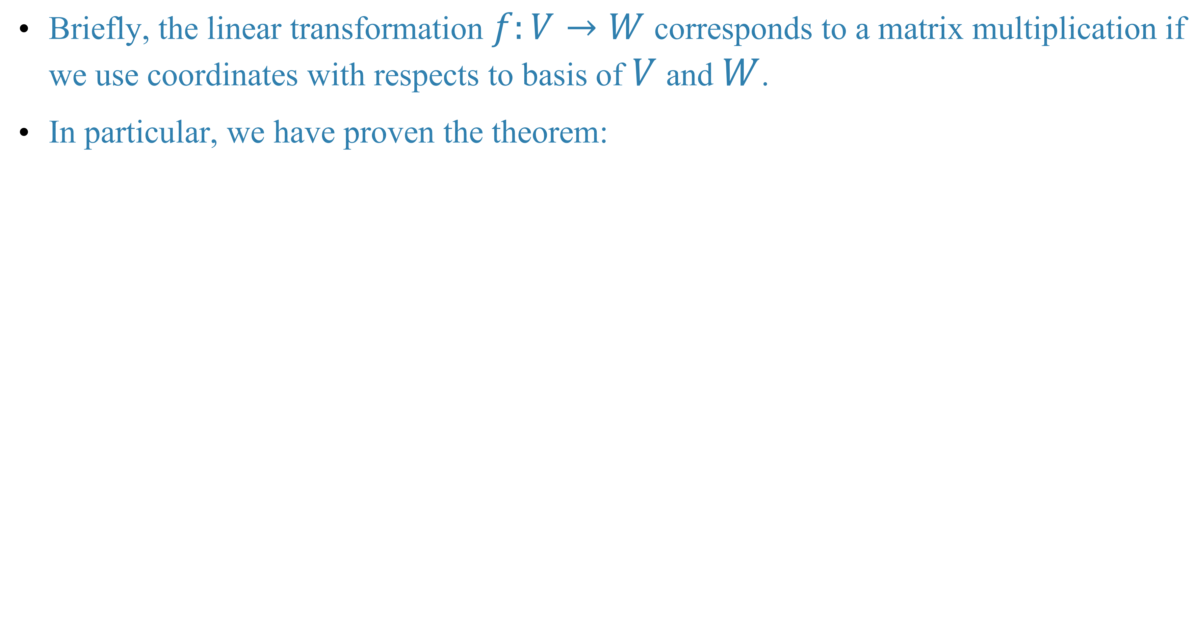
Briefly, the linear transformation $f:V→W$ corresponds to a matrix multiplication if we use coordinates with respects to basis of $V$ and $W$.
In particular, we have proven the theorem:

Slide 14
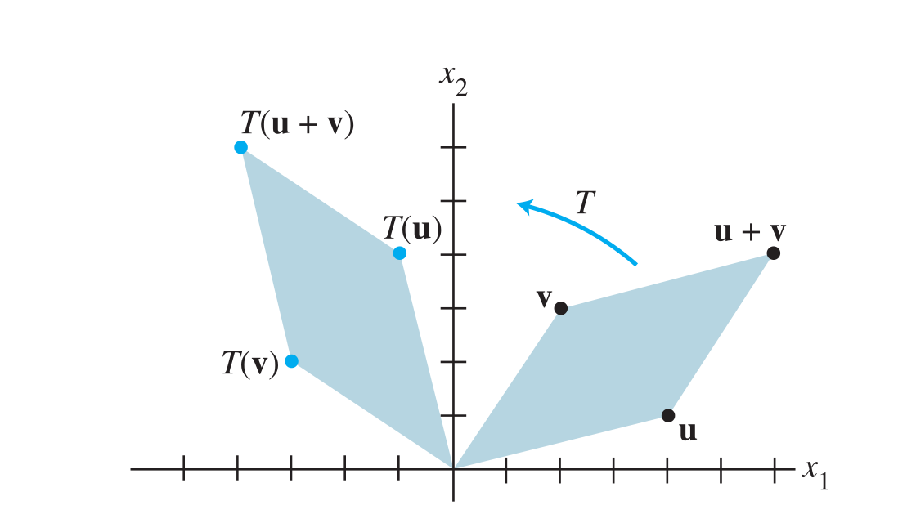
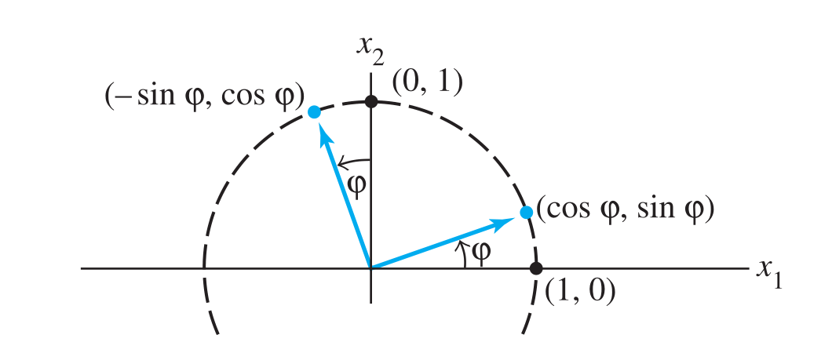
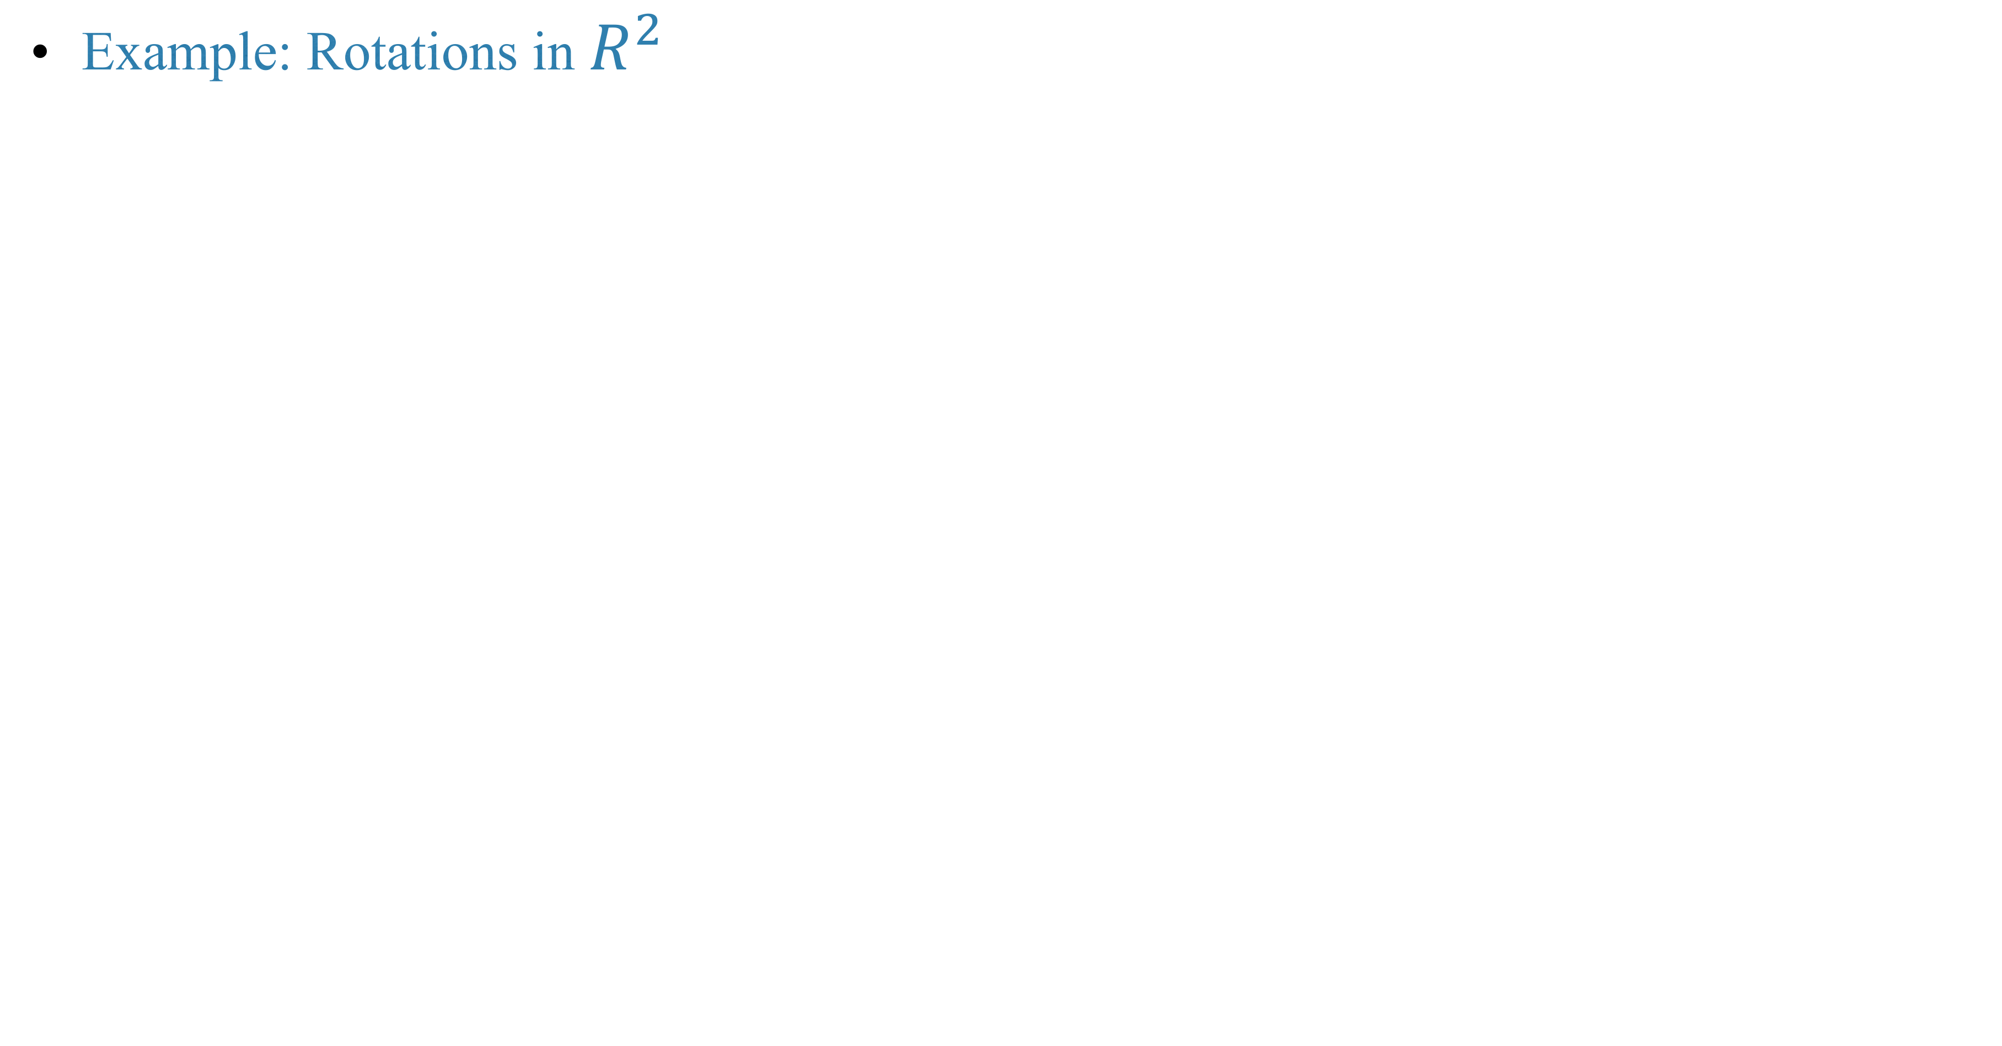
Example: Rotations in $R^{2}$

Slide 16
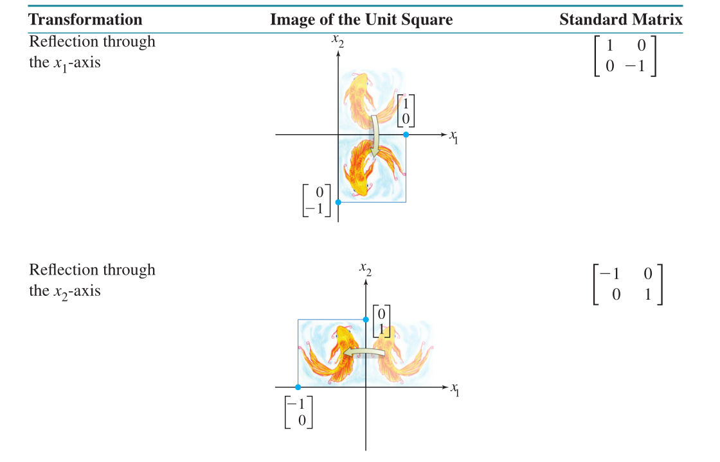
Example: Reflection with respect to a line

Slide 17
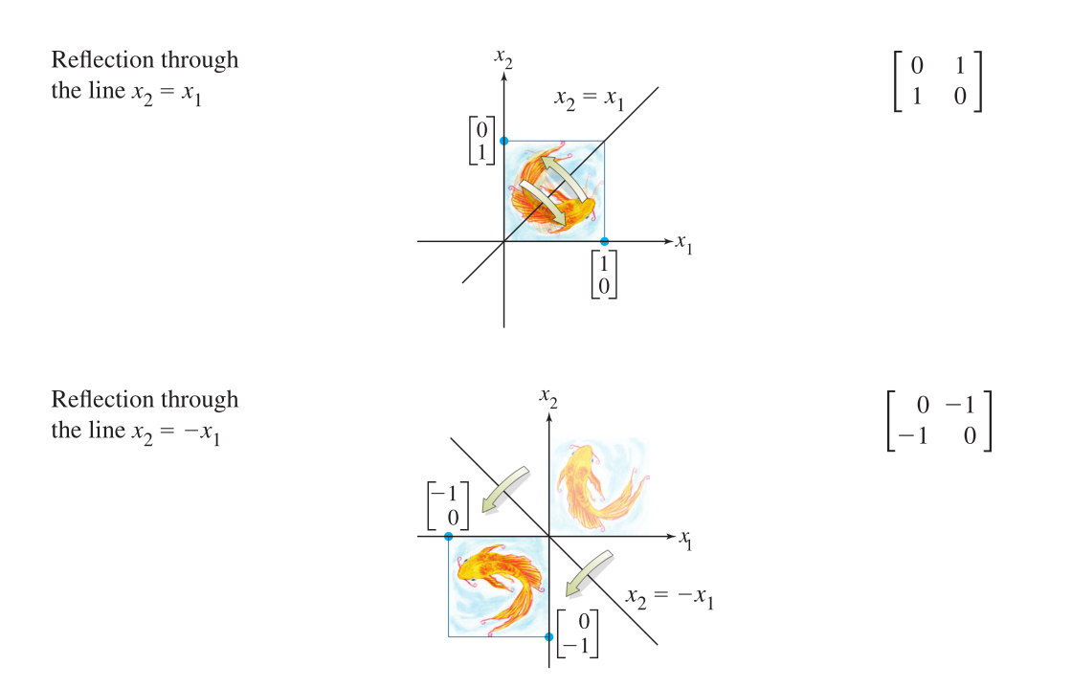

Slide 18
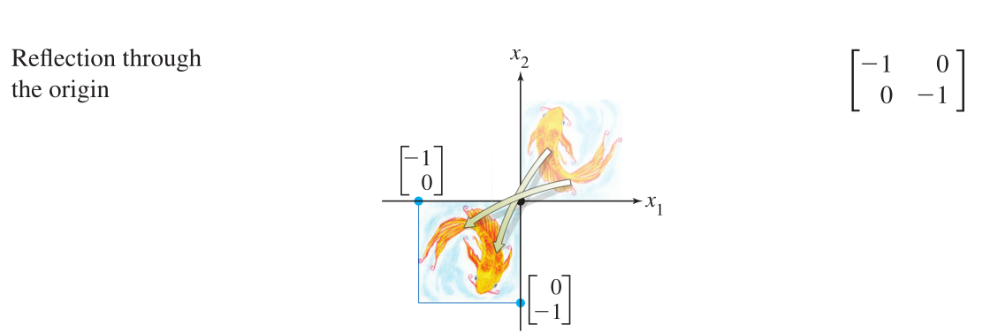
Example: Reflection with respect to the origin

Slide 19
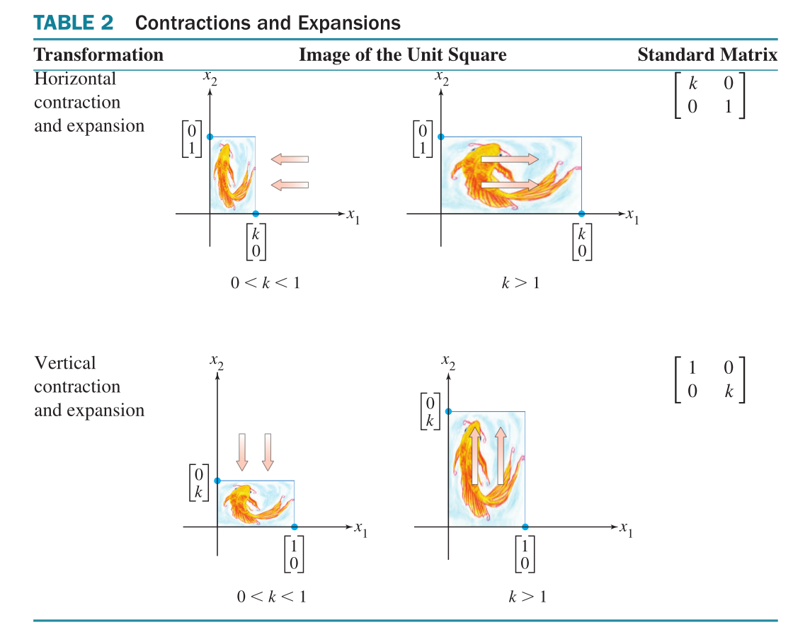
Example: Contraction and expansion

Slide 20
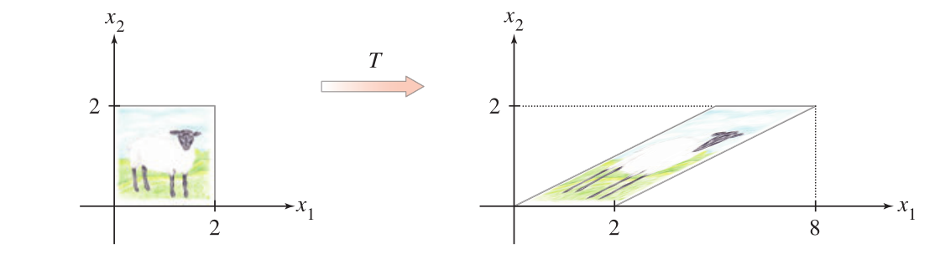
Example: Shear transformation(剪切变换)

Slide 21
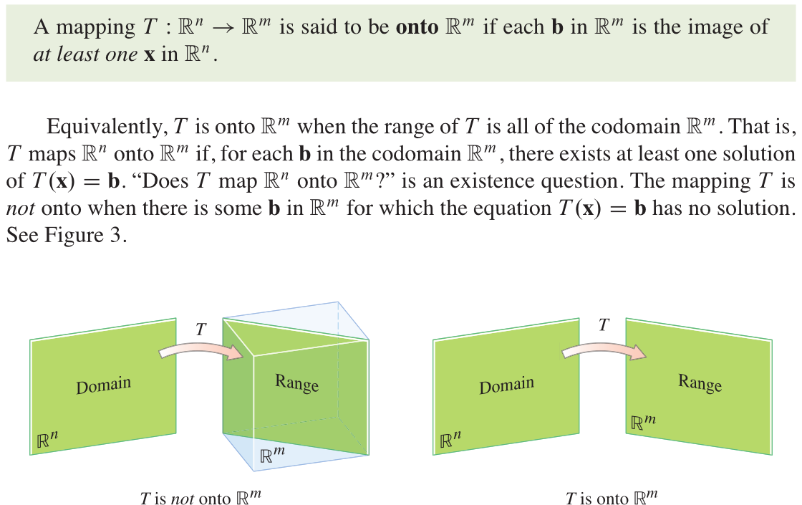
Terminology: Surjective mapping (满射)

Slide 22
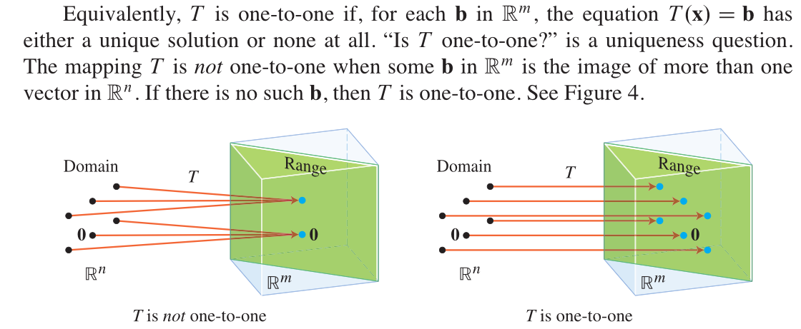
Terminology: Injective mapping (单射)

Slide 23
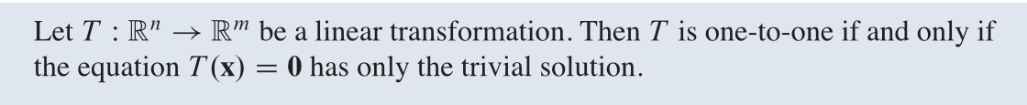
Theorem

Slide 24
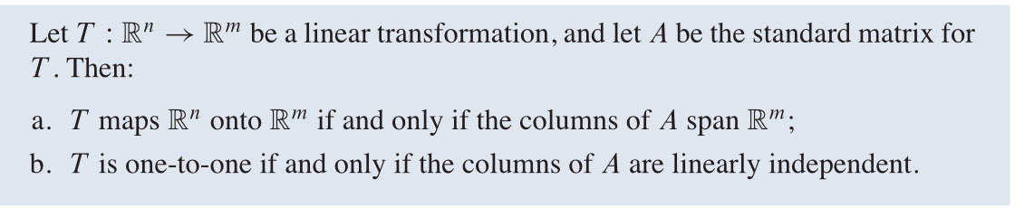
Theorem

Slide 26
Homework
Lay-Lay-McDonald, 1.8 exercise 10, 12, 30, 31.
Lay-Lay-McDonald, 1.9 exercise 8, 11, 24.

Slide 27
Next time
Lay-Lay-McDonald, chapter 2, 2.1-2.2.

